Slide 1
Text Guided 3D Shape Synthesis
Presentation 1

Slide 2
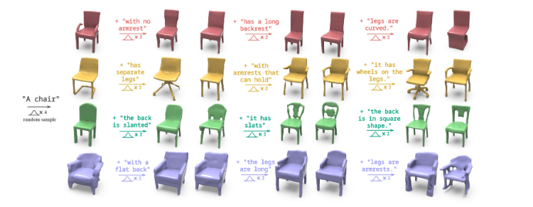
Project Introduction
The main idea is to generate 3D shapes from a given text prompt recursively.
Knowing the exact requirements from the beginning is a hard task.
Humans generally think and formulate their requirements in a recursive manner – we are good at identifying that this is not what we want.
Think agile software development
The aim is to receive text input at every time step and modify the next generated shape according to the current input and all previous input.

Slide 3
Related Work
ShapeCrafter: A Recursive Text-Conditioned 3D Shape Generation Model
Our main reference for this project – discussed in detail later.
AutoSDF: Shape Priors for 3D Completion, Reconstruction, and Generation
Learn shape representation and automatically generate a low resolution quantized vector representations of 3D shapes
Train and used for our encoder
Text2Shape: Generating Shapes from Natural Language by Learning Joint Embeddings
Created a dataset containing shape and their corresponding single sentence text descipription
8,447 tables and 6,591 chairs from shapenet
DISN: Deep Implicit Surface Network for High-quality Single-view 3D Reconstruction
Focus on single view reconstruction from a 2D image by predicting the SDF
Used same data preprocessing steps

Slide 4
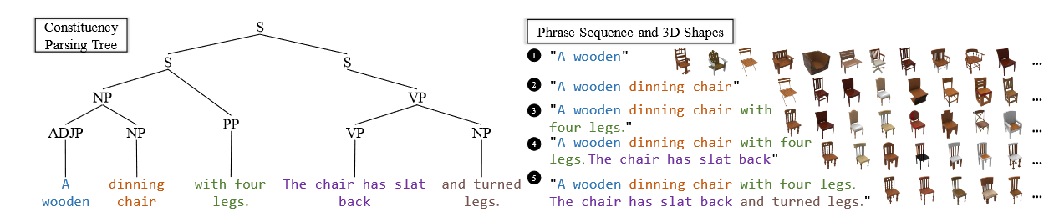
Datasets
Recall that the Text2Shape dataset only has single sentences correspondences – not suitable for our recursive task
Ran text2Shape++ dataset script to produce phrase sequences (369K text–shape pairs). Each phrase corresponds to one more shapes (shape set)
Based constituency parsing & similarity score between phrases
Ran DISN preprocessing to obtain SDF representation of the shapenet models – 64^3 resolution

Slide 5
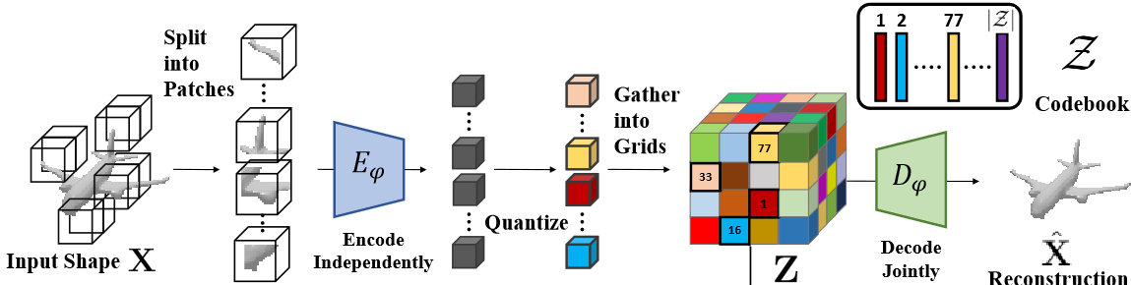
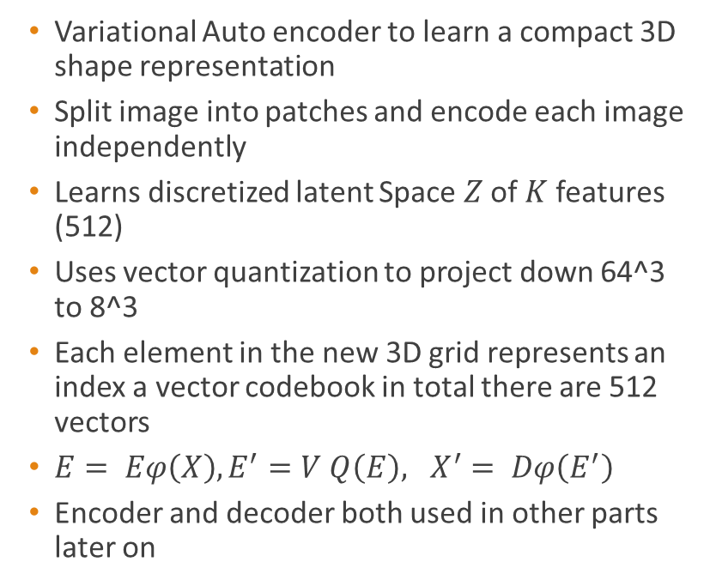
Main Architecture & Steps - PVQVAE Model
Variational Auto encoder to learn a compact 3D shape representation
Split image into patches and encode each image independently
Learns discretized latent Space $Z$ of $K$ features (512)
Uses vector quantization to project down 64^3 to 8^3
Each element in the new 3D grid represents an index a vector codebook in total there are 512 vectors
$E= Eφ\left(X\right), E^{′}=V Q\left(E\right), X^{′}= Dφ\left(E^{′}\right)$
Encoder and decoder both used in other parts later on

Slide 6
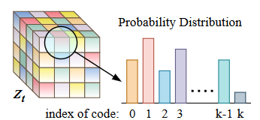
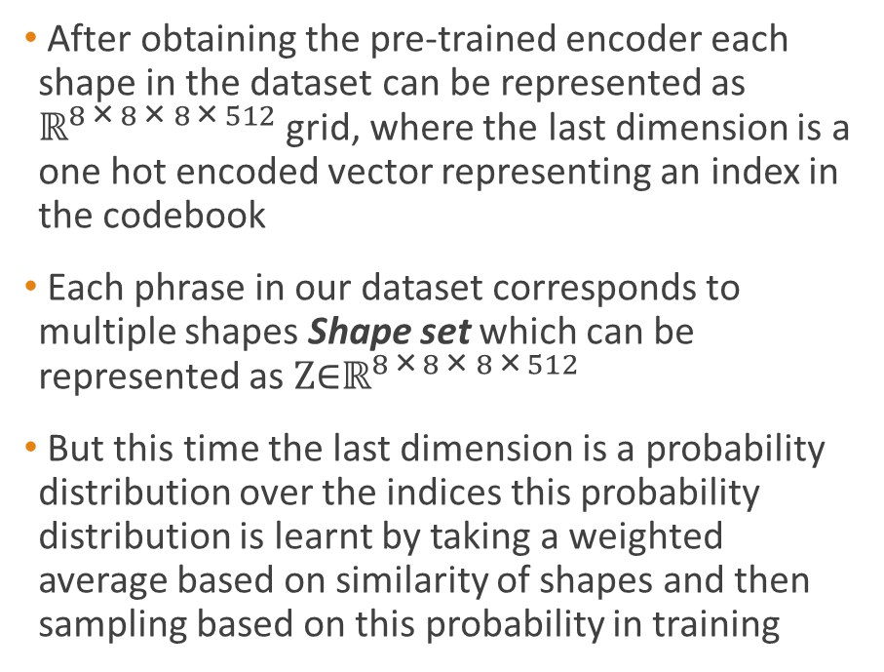
Main Architecture & Steps – Obtaining single and shape set representations
After obtaining the pre-trained encoder each shape in the dataset can be represented as ${\text{ℝ}}^{8 \text{×} 8 \text{× }8 \text{×} 512}$ grid, where the last dimension is a one hot encoded vector representing an index in the codebook
Each phrase in our dataset corresponds to multiple shapes Shape set which can be represented as ${\text{Z}\text{∈}\text{ℝ}}^{8 \text{×} 8 \text{× }8 \text{×} 512}$
But this time the last dimension is a probability distribution over the indices this probability distribution is learnt by taking a weighted average based on similarity of shapes and then sampling based on this probability in training

Slide 7



Main Components & Architecture – Text Projection model
Uses Pre-trained Bert model to project input text to an embedding vector ${\text{ℝ}}^{786}$
Then a projection model projects the Bert embeddings to ${\text{ℝ}}^{8 \text{×} 8 \text{×} 8 \text{×} 512}$
It becomes the same dimensions as our input 3D shape representation
The projection model is composed of a 3 layer MLP, a projection MLP layer to ${\text{ℝ}}^{8 \text{×} 8 \text{× }8}$ and then a 3D convolution to ${\text{ℝ}}^{8 \text{×} 8 \text{× }8 \text{×} 512}$
$${\text{ℝ}}^{786}$$
1024
1024
1024
512
8 x 8 x 8
3D conv 512 channels

Slide 8
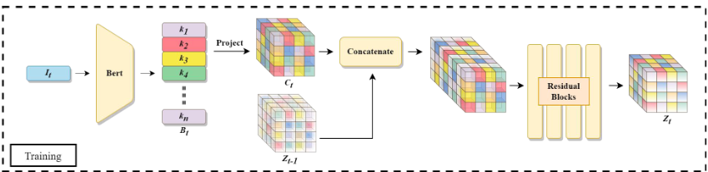

Main Components & Architecture – Combining with Single Shapes and Shape sets
After obtaining the text embedding at time step $t$ it is concatenated with the previous Z from $t−1$ across the channel dimension.
The combined vector is passed through a series of residual blocks and final convolution is applied to receive the dimensions corresponding to the codebook number of vectors
$Zt = Ψ([Zt−1, C]){\text{∈}\text{ℝ}}^{8 \text{×} 8 \text{× }8 \text{×}512}$

Slide 9
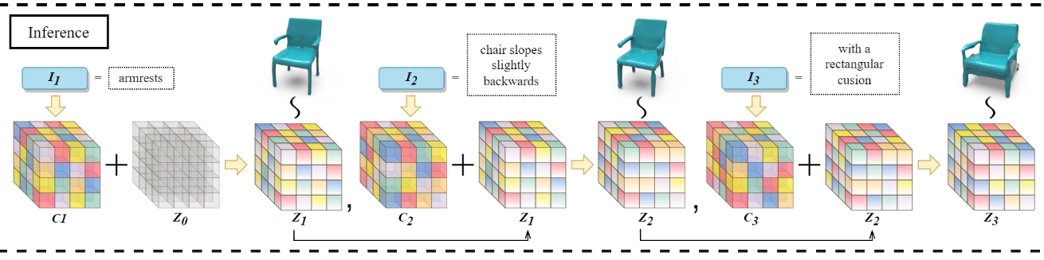
Main Components & Architecture – Autoregressive model
An auto regressive model is trained to transform from the latent space learnt by the text projection model to the code book indices
The output of the auto regressive model is passed on to the PVQVAE trained decoder to output a 3D shape
The auto regressive model consists of a random transformer

Slide 10
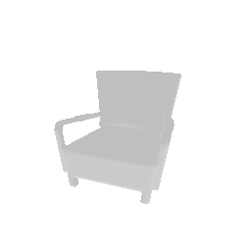
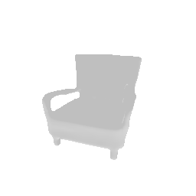
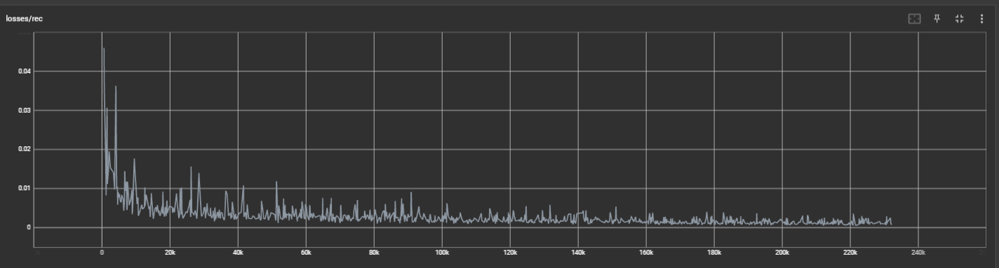
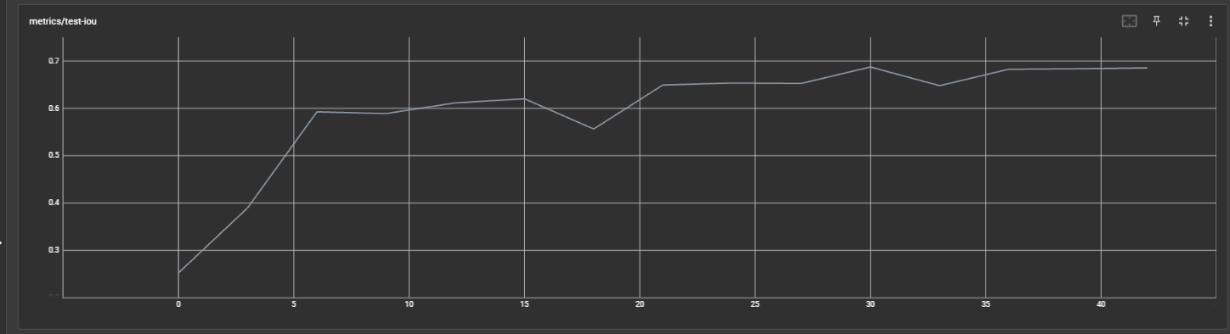
Experiments and Trainings – PVQVAE Model
Trained for 100 epochs
Used an L1 reconstruction loss
Original
Reconstruction

Slide 11
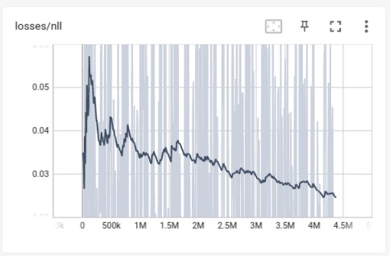
Experiments and Trainings – Text Projection Model
Trained on 100 epochs
Used a cross entropy loss
Trained on both single shapes and shape sets

Slide 12

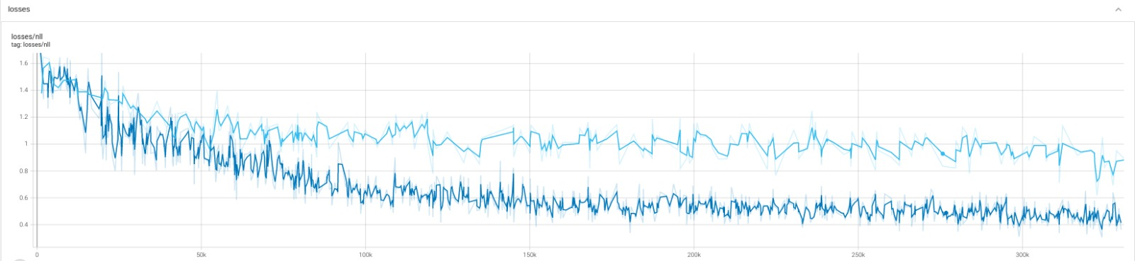
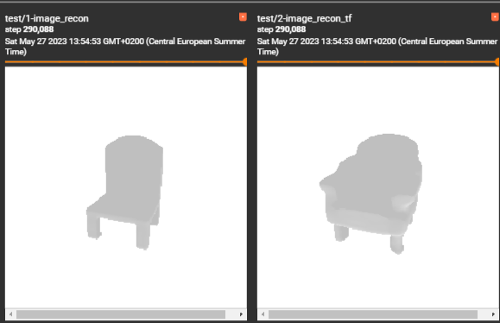
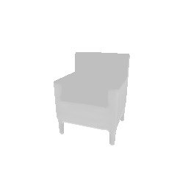
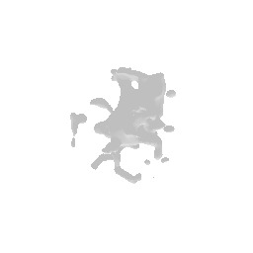
Experiments and Trainings – Auto Regressive Model
Trained on 100 epochs
Used a cross entropy loss
Trained on single shapes only, results were better on single shapes only
Beginning of training – step 8
Single Shape Training
Shape set training

Slide 13
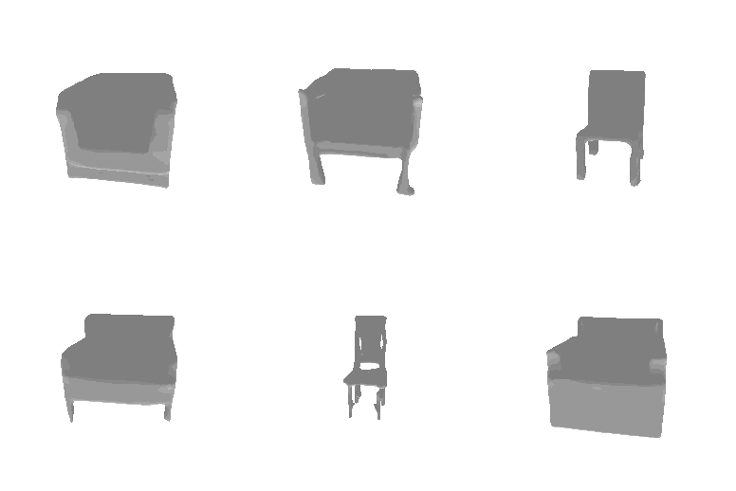
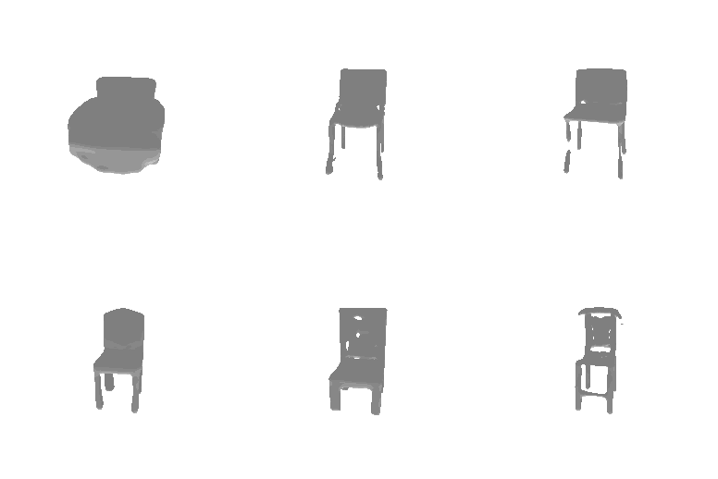
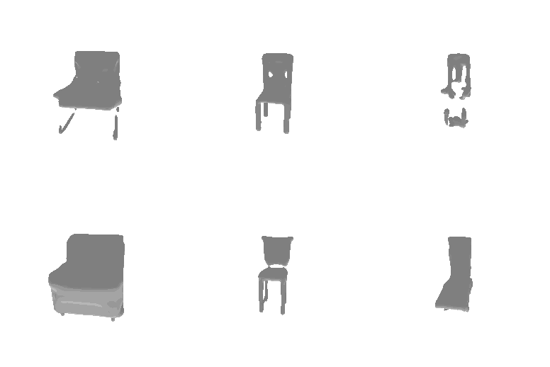
Experiments and Trainings – Sample Results
type seat has a molded curve seat
type seat has a molded curve seat has a metal footrest and circular base
Type seat

Slide 14
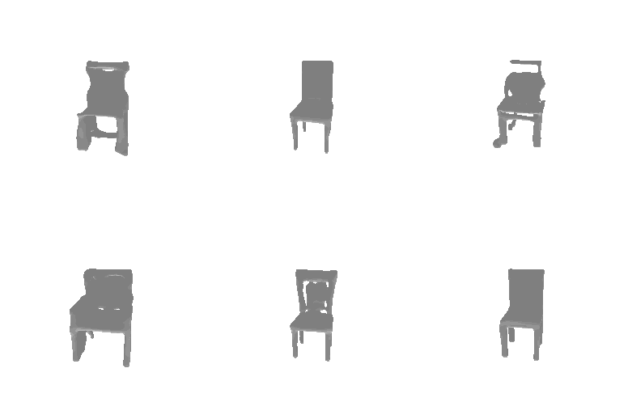
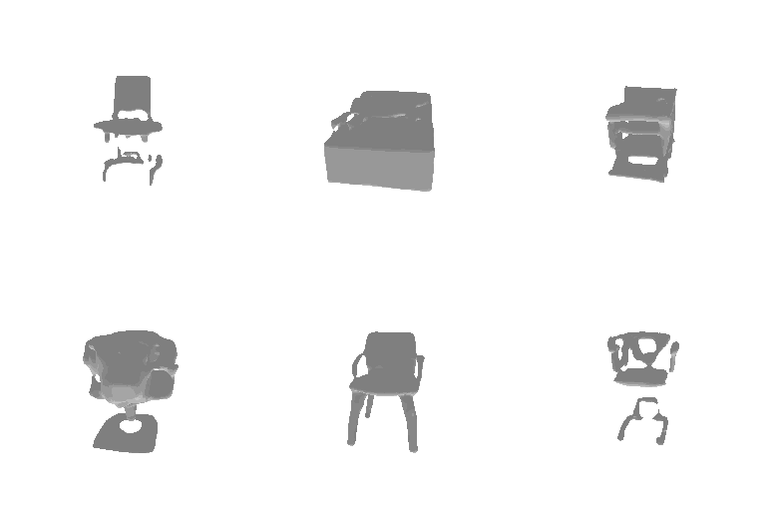
Experiments and Trainings – Sample Results
type seat has a molded curve seat has a metal footrest and circular base a white metallic chair
type seat has a molded curve seat has a metal footrest and circular base a white metallic chair with stand legs

Slide 15
Challenges
Dataset size is huge with very limited resources
Unclear parts about how certain components were implemented in the paper
Extracting shape sets and single

Slide 16
Conclusion and Next Steps
The PVQVAE model and Text Projection models work relatively well
Autoregressive model not very well yet
Not very accurate shape generation given the input text queries
Try more fine tuning and analysis to obtain more accurate results
Try to reverse the process and generate text descriptions from input 3D shapes

Slide 17
References
Fu, Rao, et al. "Shapecrafter: A recursive text-conditioned 3d shape generation model." arXiv preprint arXiv:2207.09446 (2022).
Mittal, Paritosh, et al. "Autosdf: Shape priors for 3d completion, reconstruction and generation." Proceedings of the IEEE/CVF Conference on Computer Vision and Pattern Recognition. 2022.
Xu, Qiangeng, et al. "Disn: Deep implicit surface network for high-quality single-view 3d reconstruction." Advances in neural information processing systems 32 (2019).
Chen, Kevin, et al. "Text2shape: Generating shapes from natural language by learning joint embeddings." Computer Vision–ACCV 2018: 14th Asian Conference on Computer Vision, Perth, Australia, December 2–6, 2018, Revised Selected Papers, Part III 14. Springer International Publishing, 2019.

